Slide 1
CAMDEW163_FT2410_GroupA_Cameron Dewar_JSL11
Agile Board - Kanban Task Management App

Slide 2
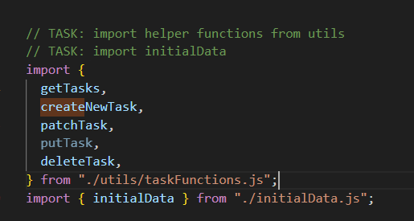
Getting started:
The basics:
Corrected imports. Note: putTask not used as it would be better suited to creating an entirely new board or full task replacement when working with API’s but isn’t as necessary when working with local storage

Slide 3
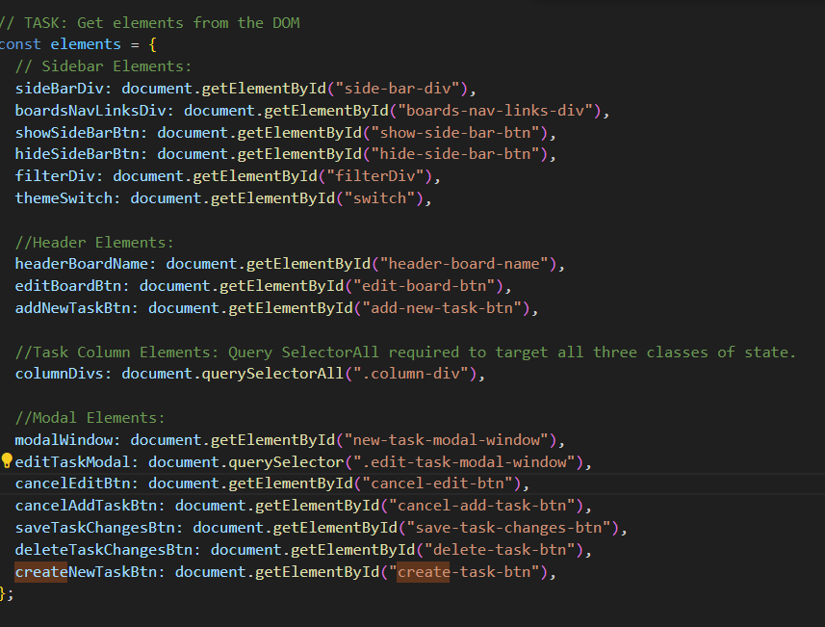
Get all the elements from the DOM
The basics:
Created const elements object to target the appropriate DOM Elements
const elements = {
//Sidebar Elements //Header Elements
//Task Column Elements
//Modal Elements
}

Slide 4
Syntax Correction
Lines 58 – 169
Semi-colon -> Colon
Quotations instead of back ticks for string literals
Not making use of brackets or correct/complete syntax
Inputing the correct parameter within provided functions
Ensuring proper equivalency checks with “===” as opposed to “=”
Correct capitalisation/camelCase for “forEach” etc.
Addition of “.classList” when styling the active board in the styleActiveBoard function

Slide 5
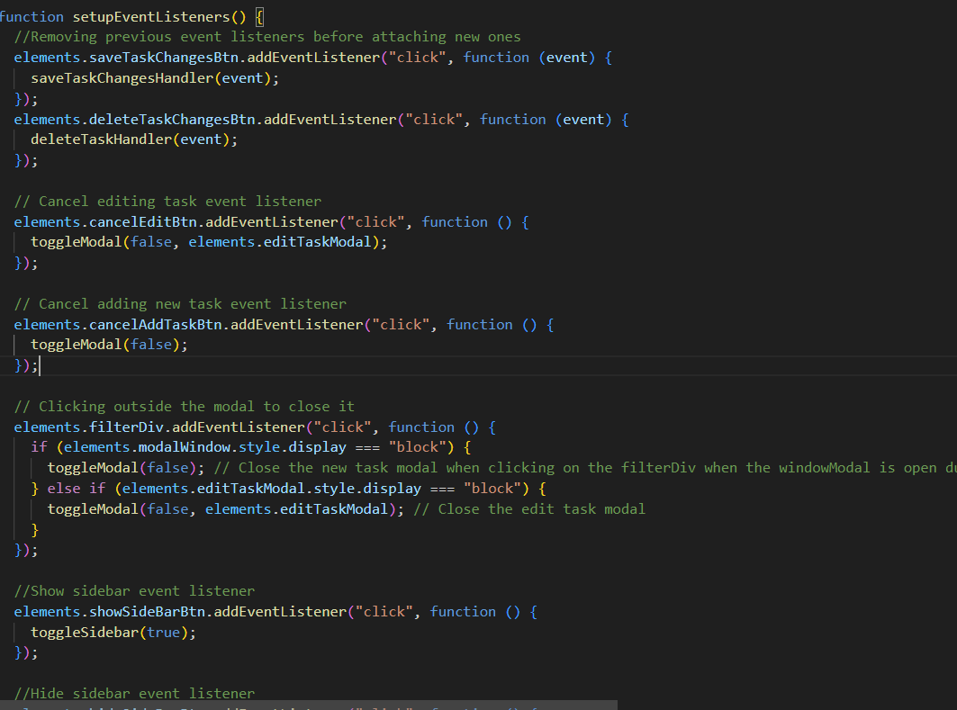
Completed event listeners and called appropriate handlers:
Some more complex than others:
involving some logic – such as the filterDiv event listener to control the visibility/closing of the modalWindow both when editing/creating new tasks.

Slide 6
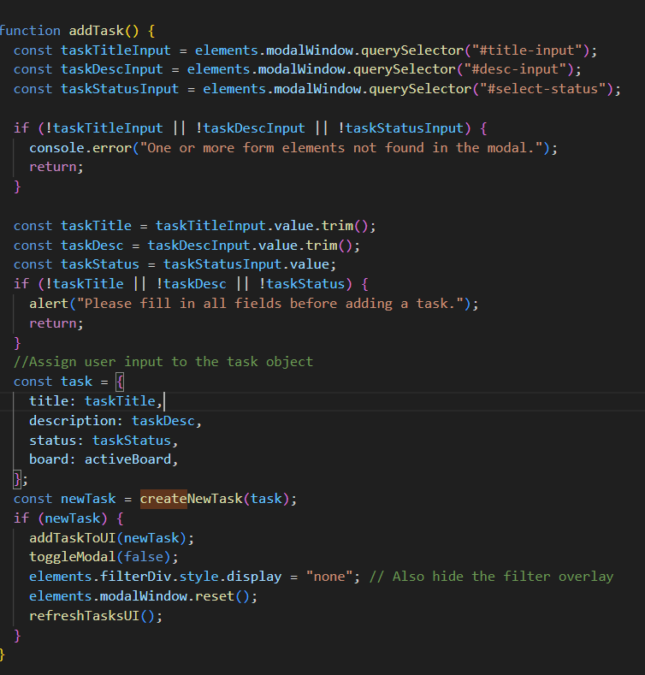
Function Logic: addTask()
created const variables to target the correct elements (titleInput/descriptionInput/statusInput)
I also made use of two if statements, the first to log an error to the console if either of those elements are not present and the second to
prevent the user from being able to create a blank entry by denying empty fields from being submitted. Alert will pop up if that is the case.

Slide 7
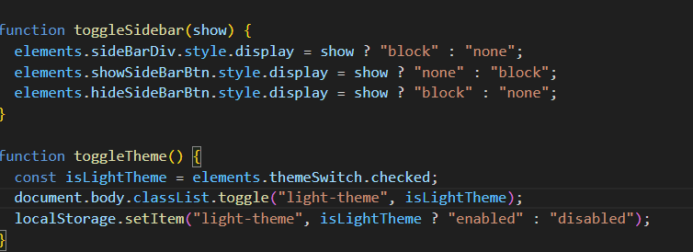
Toggle Functions
SideBar & Theme:
Completed both functions to target the correct elements and set the appropriate state relative to those elements.

Slide 8
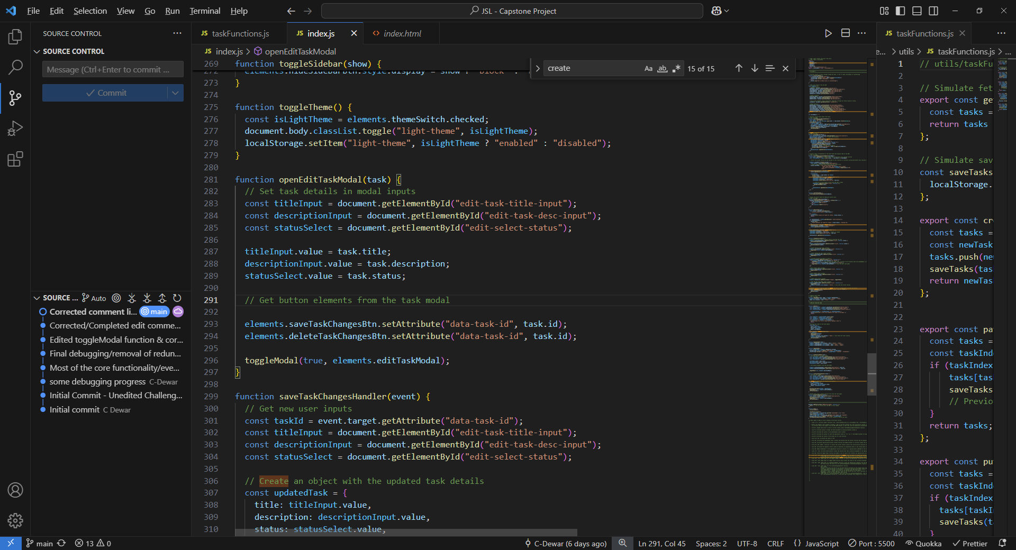
OpenEditTaskModal Function:
Targets the correct DOM elements and assigns the edited modal values to the appropriate fields. Assigns the task.id to the save and delete task buttons.

Slide 9
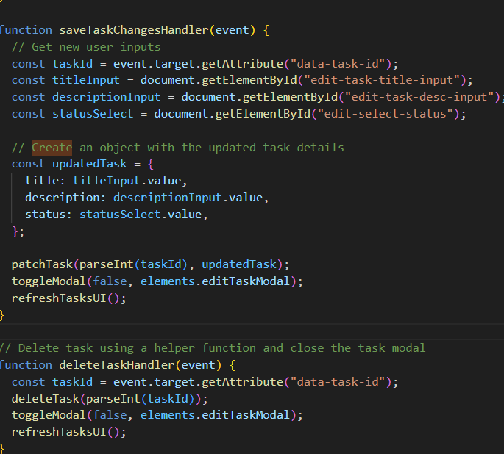
SaveTaskChangesHandler Function & deleteTaskHandler Function
User inputs:
taskId -> retrieves the task id via the data-task-id attribute of the element that triggered the event. (i.e. save button, to which the unique task Id was assigned)
titleInput, descriptionInput & statusInput -> retrieves the appropriate HTML elements from the DOM of the task modal inputs that are being edited
const updatedTask -> Assigns the values of the edited fields to a new object
patchTask -> used to update specific fields of the edited task and I had to parseInt the resulting updated Task value, as that Id was a string, instead of an integer.
toggleModal called to close the modal upon saving.

Slide 10
OpenEditTaskModal Function:
Targets the correct DOM elements and assigns the edited modal values to the appropriate fields. Assigns the task.id to the save and delete task buttons.

Slide 11
Thank you for your time!

